Slide 1
Presents
OO Programming with Java
Enums
Notes:
Enums
Module 18

Slide 2
Learning Objectives
Understand what an enum is and why they are needed
Learn how to declare an enum
Extend an enum
Use an enum with generics
Use an enum in code

Slide 3
What is an Enum?
An enum type is a type whose fields consist of a fixed set of constant values.
The field names are identifiers that are used as constants.
An enum always extends java.lang.Enum.
  Enums are class files with some additional capabilities, but like other classes, can have additional data and behavior.

Slide 4
When to Use Enums
You should use enum types any time you need to represent a fixed set of constants.
That includes natural enum types such as the planets in our solar system and data sets where you know all possible values at compile time—for example, the choices on a menu, command line flags, and so on.

Slide 5
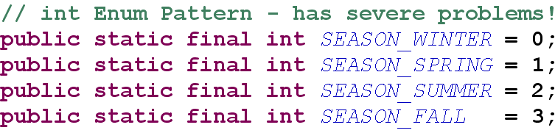
Enums
Originally, enumerations were often represented as a set of int constant values.

Slide 6
Problems with JDK 1.4 Enums
Not type safe - Since a enum is just an int you can pass in any other int value where a the enum is required.
No namespace - You must prefix constants of an int enum with a string to avoid collisions in the namespace.
Brittleness - If a new constant is added between two existing constants or the order is changed, clients of the enum must be recompiled.
Printed values are uninformative - if you print a 1.4 enum, all you get is a number, not what it represents, or what type it is.

Slide 7
Enum Types
An enumerated type is a type whose instances describe values, where the set of possible values is finite.
  i.e. the four points of the compass:
Used when the most important information is the existence of the value.
  Classes with additional data or behavior requirements would usually not consider enumerated types though enums may have attributes.

Slide 8
Extending an Enum
Java does not support inheritance of an enum.
  Enums represent a set of finite elements.
  Derived classes would increase the size of the set.
In Java, enum is an implementation of the Flyweight pattern. ( A set of Singletons ).

Slide 9
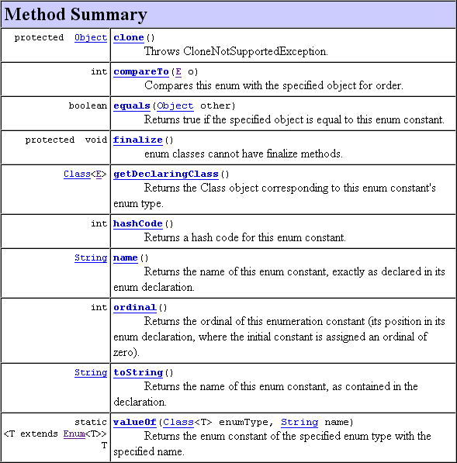
Enum Methods

Slide 10
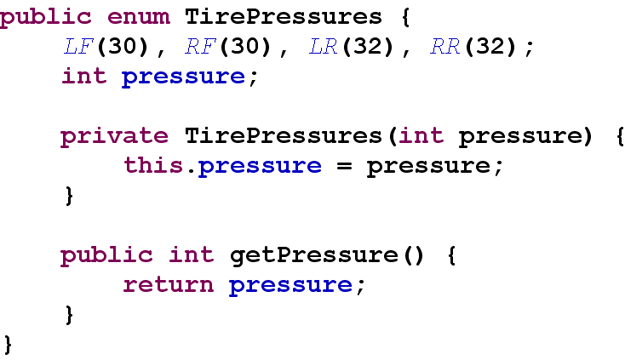
Add Fields to an Enum
Enums are treated as classes with specialized constructors.

Slide 11
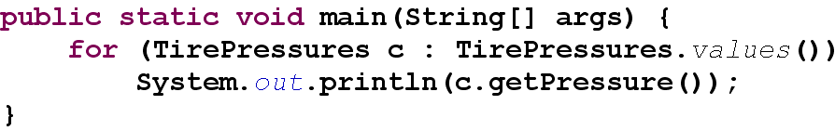
Listing the Fields of an Enum
The values() method on the enum class returns a List of the enum type.
  Loop through the list and invoke methods on each instance.

Slide 12
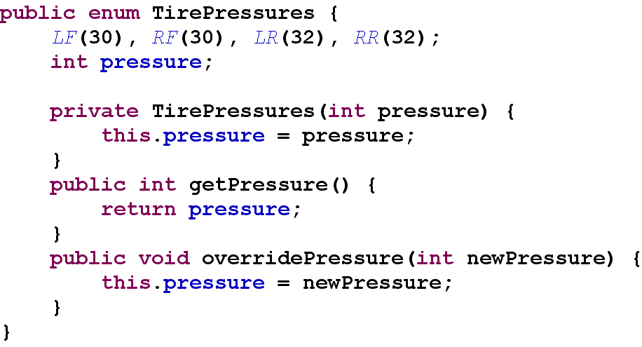
Adding Methods to an Enum
An enum may have any number of methods, but only one constructor.

Slide 13
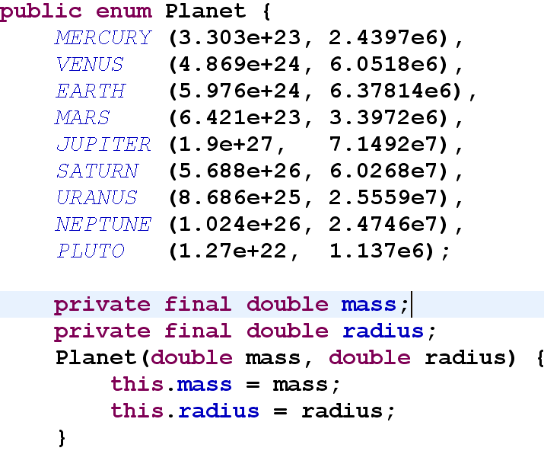
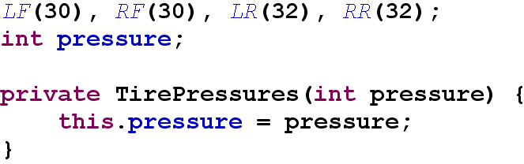
Enum Constructors
An enum may have a single constructor using the name of that instance of the enum.

Slide 14
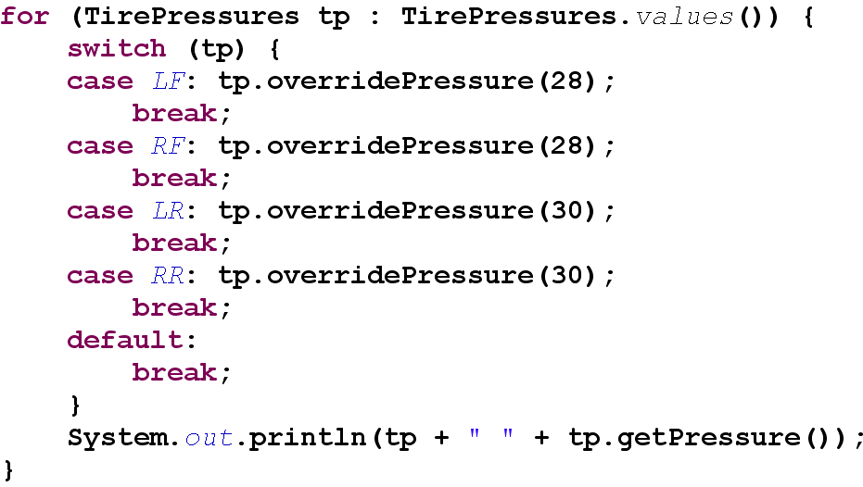
Enums in Switch/Case
An enum is used as the integral value of the switch.

Slide 15
Summary
Enums are often used to represent things that have a fixed set of values that constrain the domain of a type.
An enum is a special type of Java class that extends the java.lang.Enum class
Because enums are now a formal part of the Java language, many of the problems with pre-Java 5 enumeration constructs have been eliminated.
Methods and attributes can be added to a enum.

